Slide 1


Insights into the Indian Premier League
The Indian Premier League (IPL) is a thrilling professional cricket league that has captivated audiences worldwide. This analysis delves into the data-driven insights that unveil the nuances of player performance and team strategies within the IPL.

Slide 2
Top Batsmen Shining Bright
Highest Run-Scorers
Batting Averages
Boundary Hitters
The analysis identifies the top-performing batsmen based on total runs scored, showcasing their consistent contributions to their teams.
Standout players with exceptional batting averages demonstrate their ability to consistently score runs and anchor their team's innings.
The analysis highlights the explosive batsmen who excel at finding the boundaries, thrilling fans with their powerful hitting.

Slide 3


Bowling Maestros Dominating the Crease
1
Wicket-Taking Prowess
The analysis shines a light on the top bowlers who have consistently taken the most wickets, disrupting the opposition's batting lineups.
2
Economical Bowling
Bowlers with exceptional economy rates have demonstrated their ability to restrict runs and maintain tight control over the game.
3
Versatile Performers
Certain bowlers have showcased their adaptability, delivering strong performances across different stages of the tournament.

Slide 4


Successful Team Strategies
Consistent Performers
The analysis identifies the teams that have consistently performed well across multiple IPL seasons, highlighting their winning formulas.
Batting First Advantage
The data reveals the impact of toss decisions, with teams batting first often enjoying a strategic edge in match outcomes.
Adaptable Approaches
Successful teams have demonstrated the ability to adapt their strategies based on match conditions and opponent strengths.

Slide 5





Emerging Talents Shaking Up the League
Breakout Performances
The analysis uncovers the stories of emerging talents who have made a significant impact in the IPL, showcasing their potential for future success.
Player Progression
The data highlights the continuous improvement of certain players, demonstrating the importance of nurturing talent and strategic player development.
Future Prospects
The insights gained from this analysis provide valuable information for teams to identify and invest in the next generation of IPL superstars.

Slide 6

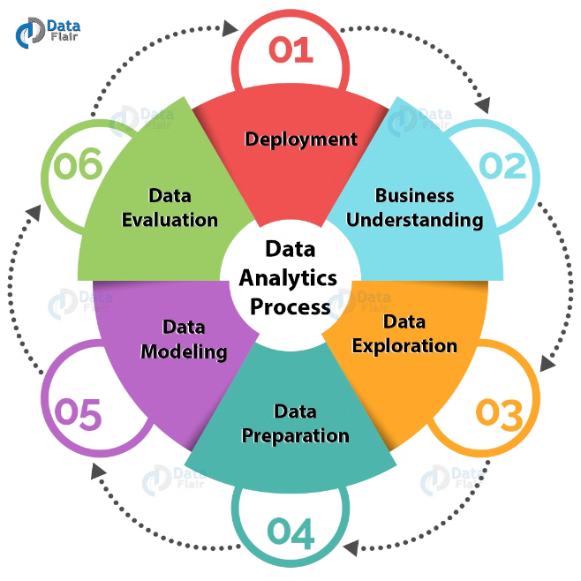
Challenges and Learnings
1
Data Cleaning
Addressing missing values, inconsistencies, and outliers in the dataset was crucial for ensuring the reliability of the analysis.
2
Handling Complexities
The analysis navigated through various data-related challenges, such as managing large datasets and interpreting null results.
3
Transparency and Reporting
The project emphasizes the importance of transparent reporting, including the communication of limitations and the credibility of the data-driven approach.

Slide 7





Significance of Data Analysis in the IPL
Informed Decisions
Data analysis empowers teams to make strategic decisions in player selection, team composition, and game planning.
Player Development
Insights from data analysis can guide the tailoring of training programs to enhance individual and team performance.
Fan Engagement
Data-driven insights enrich the viewing experience for fans, providing a deeper understanding of the game's dynamics.

Slide 8

Continuous Improvement and Evolution
Adapting Strategies
Teams leverage data-driven insights to continuously refine their strategies and adapt to changing match conditions.
Enhancing Competitiveness
The cyclical nature of the IPL allows for the incorporation of data analysis to drive the league's ongoing evolution and competitiveness.
Shaping the Future
The insights gained from this analysis contribute to the long-term growth and development of the Indian Premier League.

Slide 9

Conclusion: Unlocking the IPL's Potential
The comprehensive data analysis of the Indian Premier League has unveiled the nuances of player performance and team strategies, empowering teams, players, and fans to better understand and appreciate the dynamics of this captivating cricket league. The insights gained from this analysis will continue to shape the future of the IPL, driving its ongoing evolution and competitiveness.

